Slide 1

Driver Fatigue Detection
Mohammad NaeemRaha

Slide 2
Introduction
The number of cars is increasing exponentially worldwide and automotive population is increasing.
with the increased number of cars the risk of accidents is also increasing.
According WHO every year, 1.3 million people die as a result of road traffic crashes
WHO reports has classified drivers’ carelessness, sleeplessness and alcoholism as one of the main reason of crashes on the roads.
intelligent transportation system (ITS) such as cruise control, park assistance control, pedestrian detection system, blind spot detection system and many more technologies.
this project is aiming to minimize its risk and it should be inbuilt with the vehicle
aim is to monitor the driver while driving and raise an alarm if the driver was not paying fully attention to the road or was drowsy

Slide 3
LITRARURE REVIEW
In road safety and driving vehicle, driver monitoring is an important topic.
Many projects have been developed for driver monitoring and detection using different technologies
Some possible techniques for monitoring are
sensing of physiological characteristics
driver operation, vehicle response
driver response
Though techniques are more accurate but it is not realistic since it requires sensing electrodes to be connected to the driver which itself can be annoying and distracting.
The technique which relies on monitoring the eyes of driver is well suited to monitor the driver (In this technique the system detects and monitors the eyes of the driver and its closure to decide whether to raise an alarm or not)
few commercial systems has been released
The driver drowsiness detection of Volvo and Mercedes Benz
though they can only be seen in high end vehicles.

Slide 4
PROPOSED SYSTEM
Several different algorithms can be used for eye tracking and monitoring.
Some of these technologies relate to features of the eye (reflection of eye) of a video image of the driver
Deep learning is used in this project to develop an intelligent model based on thousands of people faces
constantly tracking drivers’ eyes and deciding if the driver’s eyes is closed or open.
Applying this model on live video which is captured from the driver will help with calculation of eye closure time
Considering that eye closure time of a drowsy driver is more than the normal blinking time which can lead disastrous accidents.
we will warn the driver as soon as closed eye is detected.

Slide 5
WORKING OF SYSTEM
SENSING PHASE:
A camera is used to take live video of the driver and save it as different frames.
EYE DETECTION:
The Har Cascade eye classifier is used to detect the eye.
EYE STATUS:
The model is used on eye detector to predict whether eyes closed or open and store its value.
RAISE WARNING:
Using the stored value, the system decides if the driver is drowsy or not and it will raise an alarm if driver is classified as drowsy.

Slide 6
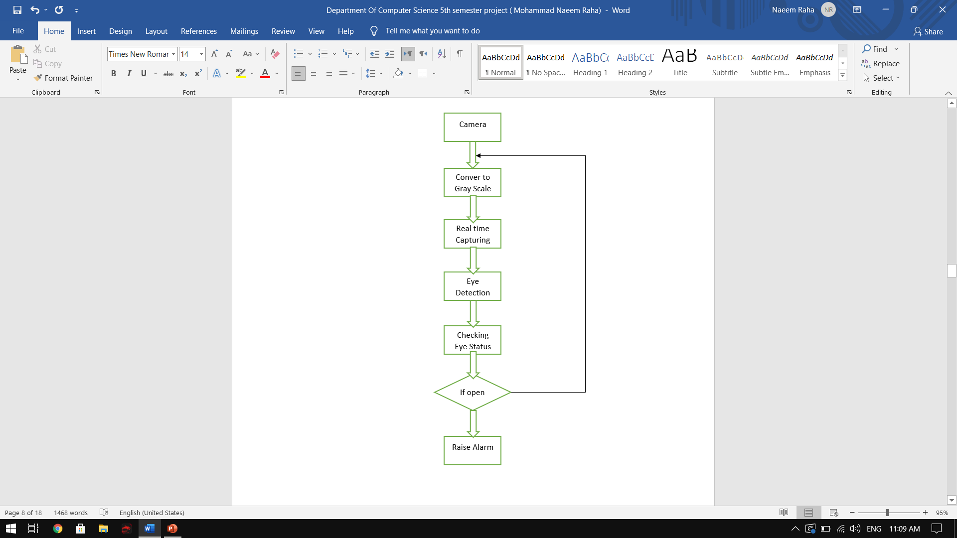
PROPOSED SYSTEM’S DIAGRAM:

Slide 7
SYSTEM REQUIRMENT
Hardware Requirements:
Camera Module
A computer such as (Raspberry Pi3)
Speaker
Software Requirements:
Jupyter notebook
Python 3.6
Libraries (TensorFlow, open cv, Keras, OS, Pygame, Time)
Operating system

Slide 8
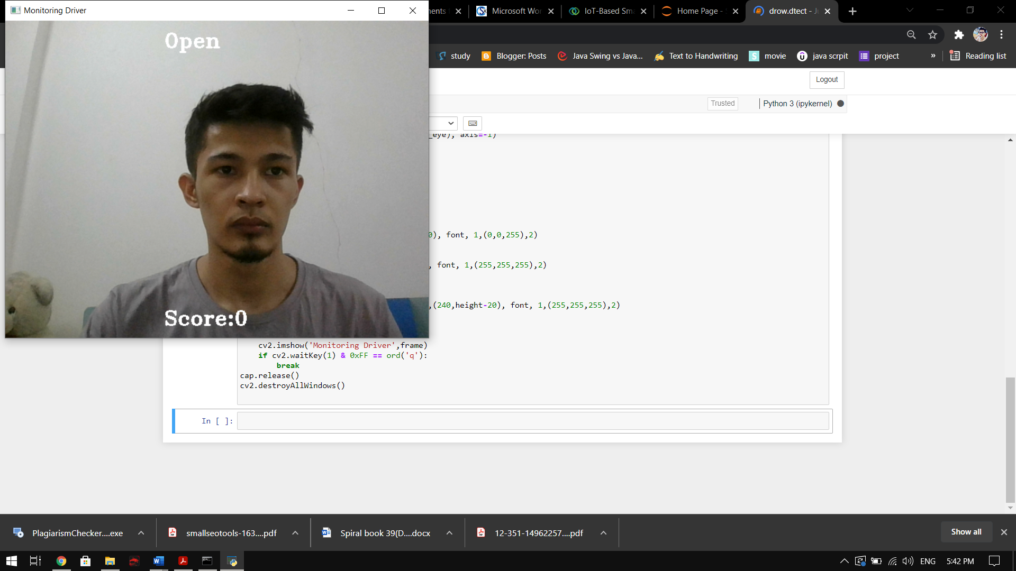

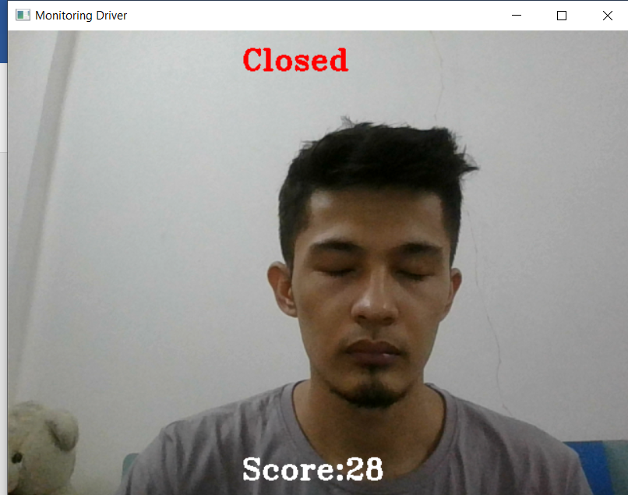
Implementation
Eye is open Eye is closed
Eye is closed and score limit has reached

Slide 9
CONCLUSION
Hardware Requirements:
The driver fatigue detestation system is detecting drowsiness in driver accurately and instantly and raise a warning when needed
Driver fatigue system is developed based on eye closure time period which can be used to differentiate between blinking and drowsiness
The system can be useful to prevent accidents due to sleeplessness of the driver which works well even if the driver is wearing specs or the lighting condition is not good.
eye position is obtained by use of Har Cascade eye detection model
The system will take the information and raise a warning based on the prediction of the model which checks if the eye was closed for too long.

